Slide 1
China since Mao
Chapter 28

Slide 2
The Communist Party After Mao

Slide 3
Communist Party after Mao
“Gang of Four” blamed for excesses of Cultural Revolution
Televised trial
Given suspended death sentence, commuted to life in prison
1978 Deng Xiaoping assumes leadership of party
Impressive revolutionary pedigree

Slide 4
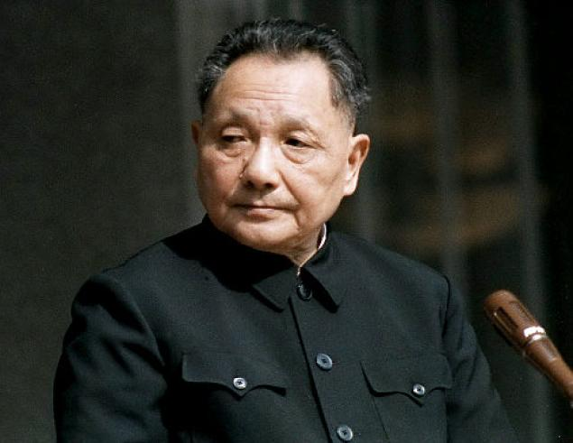
Deng Xiaoping
Revolutionary Pedigree
1920s active in France
Shanghai underground
Long March
Member of Standing Comm. And Secretary General of Party
Pragmatist
“poverty is not socialism”
“to get rich is glorious”

Slide 5
Four Modernizations
Agriculture, industry, science and technology, defense
Aim to turn China into modern industrial state
Merit reward; professional and individual initiative encouraged
Market liberalized
1000s return home to make up for “wasted years”

Slide 6
Four Modernizations
Agriculture, industry, science and technology, defense
Agriculture decollectivized
“responsibility system” peasants assigned land on contract
Resembled equal-field system
Enterprising peasants did well

Slide 7
Four Modernizations
Agriculture, industry, science and technology, defense
Agriculture decollectivized
Industry liberalized
Companies expected to make a profit
Government regulation decreased
Private commerce allowed

Slide 8
Four Modernizations
Agriculture, industry, science and technology, defense
Agriculture decollectivized
Industry liberalized
Special economic zones
Foreign investment encouraged
Western teachers brought to China to teach English and other foreign languages
Christian churches, Buddhist and Taoist temples reopen

Slide 9
Tiananmen Square Protest
Protest movements on University Campuses
Spontaneous student movement following death of Hu Yaobang, liberal reformer
Students gather at Tiananmen Square to mourn Hu
Evolves to protest movement demanding more liberal reform
Student led Hunger Strikes; movement spreads to other universities
More people come to Tiananmen Square (estimates 1 million)

Slide 10
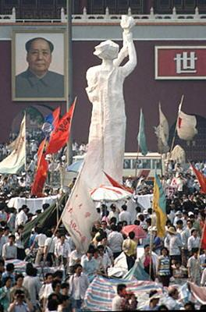
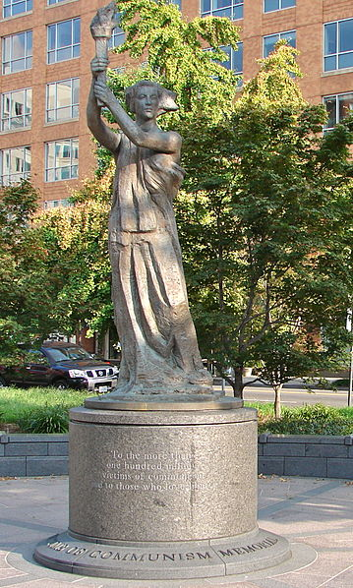
Tiananmen Square Protest
Students erect statue of Goddess of Democracy
33 foot, foam and papier-mâché over metal frame
Tall as possible
Government would either have to destroy it or leave it standing
Statement by creators
Notes:
At this grim moment, what we need most is to remain calm and united in a single purpose. We need a powerful cementing force to strengthen our resolve: That is the Goddess of Democracy. Democracy…You are the symbol of every student in the Square, of the hearts of millions of people. …Today, here in the People’s Square, the people’s Goddess stands tall and announces to the whole world: A consciousness of democracy has awakened among the Chinese people! The new era has begun! …The statue of the Goddess of Democracy is made of plaster, and of course cannot stand here forever. But as the symbol of the people’s hearts, she is divine and inviolate. Let those who would sully her beware: the people will not permit this! …On the day when real democracy and freedom come to China, we must erect another Goddess of Democracy here in the Square, monumental, towering, and permanent. We have strong faith that that day will come at last. We have still another hope: Chinese people, arise! Erect the statue of the Goddess of Democracy in your millions of hearts! Long live the people! Long live freedom! Long live democracy!

Slide 11
Tiananmen Square Protest
Students erect statue of Goddess of Democracy
Cui Jian
Performed live at Tiananmen
“Nothing to My Name” becomes anthem of movement
Notes:
At this grim moment, what we need most is to remain calm and united in a single purpose. We need a powerful cementing force to strengthen our resolve: That is the Goddess of Democracy. Democracy…You are the symbol of every student in the Square, of the hearts of millions of people. …Today, here in the People’s Square, the people’s Goddess stands tall and announces to the whole world: A consciousness of democracy has awakened among the Chinese people! The new era has begun! …The statue of the Goddess of Democracy is made of plaster, and of course cannot stand here forever. But as the symbol of the people’s hearts, she is divine and inviolate. Let those who would sully her beware: the people will not permit this! …On the day when real democracy and freedom come to China, we must erect another Goddess of Democracy here in the Square, monumental, towering, and permanent. We have strong faith that that day will come at last. We have still another hope: Chinese people, arise! Erect the statue of the Goddess of Democracy in your millions of hearts! Long live the people! Long live freedom! Long live democracy!

Slide 12
Tiananment Square Massacre
June 4-5, 1989 Marshal Law Declared
Military mobilized to clear square
Tank Man
Estimates between 100s and 1000s of deaths

Slide 13
Social and Cultural Changes

Slide 14
“literature of the wounded”
Emerges soon after death of Mao and fall of the “Gang of Four”
Portrays suffering during the Cultural Revolution
Focuses on trauma and oppression
But with faith to solve social problems
“Beijing Spring” allows greater openness and less party control of literature
Came under attack by Conservatives as “bourgeois liberalism”

Slide 15
Fifth Generation
Graduates of Beijing Film Academy in 1982
Literature of Wounded paves way for frank and open discussion
Chen Kaige’s “Yellow Earth” marks beginning of movement
Cinematography by Zhang Yimou
Zhang Yimou receives wide international acclaim
Ju Dou, Raise the Red Lantern, and Red Sorghum

Slide 16
Fifth Generation
Graduates of Beijing Film Academy in 1982
Literature of Wounded paves way for frank and open discussion
Chen Kaige’s “Yellow Earth” marks beginning of movement
Zhang Yimou receives wide international acclaim
Rejection of social realist tradition; some films banned
Use of color

